Slide 1


Accenture Innovation Challenge
Harness Generative AI to develop innovative solutions that boost business and societal growth

Slide 2
Instructions Reference slide– Remove before submission
Use the given template for your idea submission.
Follow file naming format: Team name_Idea Name.pptx
Ensure the spell check is done before submitting
Use standard Arial font, alignment and relevant images (as required)

Slide 3
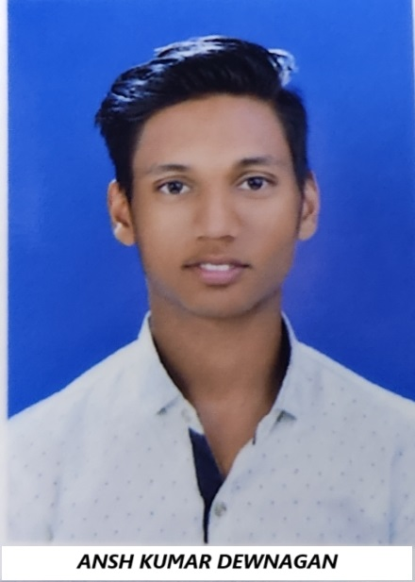



Team details
TEAM NAME: CoderJokers
Ansh Kumar Dewangan
Babloo Yadav
College: Rungta college of technology and engineering R1
Stream: Master of Computer Application
Year of graduation: 2024
College: Rungta college of technology and engineering R1
Stream: Master of Computer Application
Year of graduation: 2024
Harsh Kumar Junghare
Rudrabhishek Soni
College: Rungta college of technology and engineering R1
Stream: Master of Computer Application
Year of graduation: 2024
College: Rungta college of technology and engineering R1
Stream: Master of Computer Application
Year of graduation: 2024
All fields are mandatory

Slide 4
Describe the problem statement (200 words)
Many coffee shops face significant challenges in providing personalized and efficient customer service. Long wait times, inconsistent quality, and a lack of personalized recommendations can lead to customer dissatisfaction and lost business. Additionally, traditional ordering methods, such as manual note-taking and verbal communication, can be error-prone and time-consuming, further contributing to operational inefficiencies.

Slide 5
Proposed solution / your big Idea (200 words)
A Generative AI-powered coffee shop assistant can revolutionize the customer experience by:
Personalized recommendations: Suggesting tailored beverage and food options based on customer preferences, past orders, and real-time feedback.
Streamlined ordering: Enabling customers to place orders verbally or through text-based interactions, eliminating manual note-taking and reducing errors.
Engaging conversations: Creating personalized interactions, providing information, and offering tailored recommendations.
Real-time feedback and suggestions: Collecting and analyzing customer feedback to improve operations and ensure high-quality products and services

Slide 6
How does your innovation accelerate change with the power of Technology? (200 words)
Our coffee shop AI assistant has the potential to significantly impact the coffee shop industry. By improving customer satisfaction, enhancing operational efficiency, and providing data-driven insights, it can help coffee shops differentiate themselves, increase revenue, and create a more sustainable business model.
ur coffee shop AI assistant demonstrates the power of generative AI to accelerate change and drive innovation. By providing personalized recommendations, streamlining operations, and offering valuable insights, it transforms the customer experience and empowers coffee shop owners to make data-driven decisions. This innovative solution has the potential to reshape the industry and create a more efficient, customer-centric coffee shop environment

Slide 7
How is your solution different/unique from other solutions in market? (150 words)
Our coffee shop AI assistant distinguishes itself from existing solutions in the market by offering a comprehensive and personalized approach to customer service. Unlike generic chatbots or simple recommendation systems, our AI assistant leverages the power of generative AI to provide a truly unique experience. Here's what sets our solution apart: Generative AI Power: Our assistant is built on a foundation of generative AI, enabling it to generate creative and personalized responses to customer queries and requests. This goes beyond simple rule-based interactions, providing a more engaging and human-like experience. Multi-Functionality: Unlike many existing solutions, our AI assistant is not limited to a single task. It can handle a variety of functions, including taking orders, providing recommendations, answering questions, and even engaging in casual conversation. Integration with Coffee Shop Systems: Our assistant is designed to seamlessly integrate with existing coffee shop systems, making it easy to implement and use. This ensures a smooth transition and minimal disruption to operations. By combining these unique features, our coffee shop AI assistant offers a truly innovative and valuable solution that can significantly enhance the customer experience and improve operational efficiency.

Slide 8
Any testimonials received?
I don't have access to specific testimonials or feedback, but I can tell you that many users appreciate the informative and conversational nature of my responses. If you have any questions or need assistance, feel free to ask!
GitHub:-https://github.com/coderwithansh/coffee-shop.git
Share the links/photos of the testimonials you’ve received

Slide 9
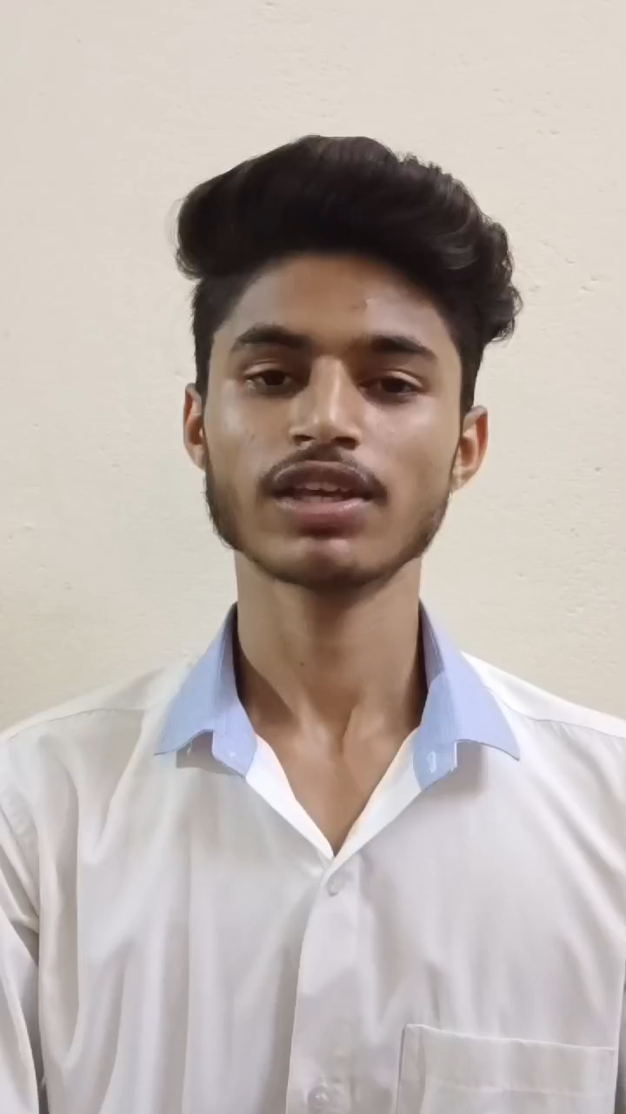
Please share a 1-minute video of your idea (embed on this PPT or add a downloadable link)
Video link:- click here….

Slide 10
Thank you!

